Slide 1
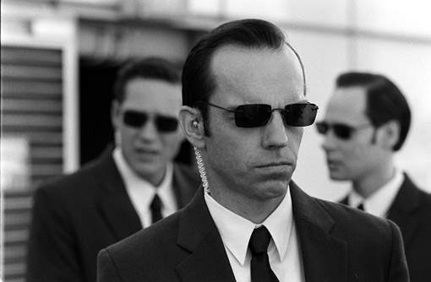
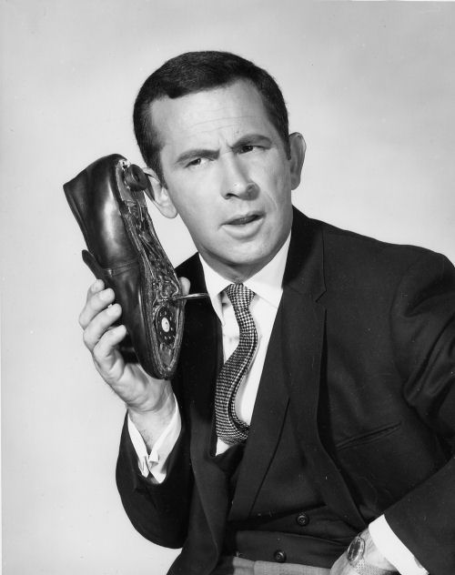
Intelligent Agents

Slide 2
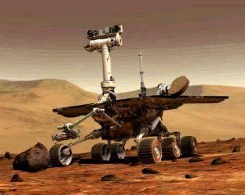
Definition of Agent
Anything that:
Perceives its environment
Acts upon its environment
A.k.a. controller, robot

Slide 3
Definition of “Environment”
The real world, or a virtual world
Rules of math/formal logic
Rules of a game
…
Specific to the problem domain

Slide 4
Agent
Sensors
Percepts
?
Environment
Actuators
Actions

Slide 5
Agent
Sensors
Percepts
?
Environment
Actuators
Actions
Sense – Plan – Act

Slide 6
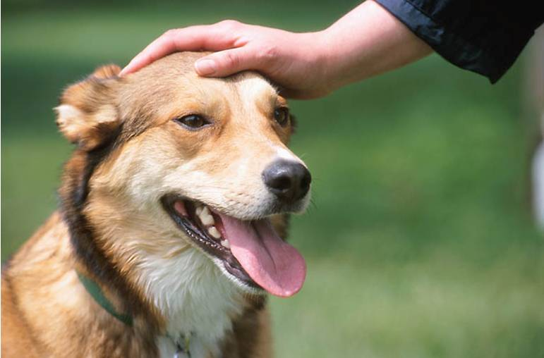
“Good” Behavior
Performance measure (aka reward, merit, cost, loss, error)
Part of the problem domain

Slide 7
Exercise
Formulate the problem domains for:
Tic-tac-toe
A web server
An insect
A student in B551
A doctor diagnosing a patient
An electronic trading system
IU’s basketball team
The U.S.A.
What is/are the:
Environment
Percepts
Actions
Performance measure
How might a “good-behaving” agent process information?

Slide 8
Types of agents
Simple reflex (aka reactive, rule-based)
Model-based
Goal-based
Utility-based (aka decision-theoretic, game-theoretic)
Learning (aka adaptive)

Slide 9
Simple Reflex
Percept
Interpreter
State
Rules
Action

Slide 10
Simple Reflex
Percept
Rules
Action

Slide 11
Simple Reflex
In observable environment, percept = state
Percept
Rules
Action

Slide 12

Rule-based Reflex Agent
A
B
if DIRTY = TRUE then SUCK
else if LOCATION = A then RIGHT
else if LOCATION = B then LEFT

Slide 13
Building a Simple Reflex Agent
Rules (aka policy): a map from states to action
a = π(s)
Can be:
Designed by hand
Precomputed to maximize performance (classes 23&24)
Learned from a “teacher” (e.g., human expert) using ML techniques
Learned from experience using reinforcement learning techniques (class 25)

Slide 14
Model-Based Reflex
Percept
Interpreter
State
Rules
Action
Action

Slide 15
Model-Based Reflex
Percept
Model
State
Rules
Action
Action

Slide 16
Model-Based Reflex
Percept
Model
State estimation
State
Rules
Action
Action

Slide 17
A Simple Model-Based Agent
State:
LOCATION
HOW-DIRTY(A)
HOW-DIRTY(B)
HAS-SEEN(A)
HAS-SEEN(B)
Rules:
if LOCATION = A then
if HAS-SEEN(B) = FALSE then RIGHT
else if HOW-DIRTY(A) > HOW-DIRTY(B) then SUCK
else RIGHT
…
A
B
Model:
HOW-DIRTY(LOCATION) = X
HAS-SEEN(LOCATION) = TRUE

Slide 18

A More Complex Model-Based Agent
Percepts: microphone input
Action: reply with information
Model: language model
State estimation = speech recognizer
Rules: semantic transformations
Performance: is the information relevant?

Slide 19
Model-Based Reflex Agents
Controllers in cars, airplanes, factories
Robot obstacle avoidance, visual servoing

Slide 20
Building a Model-based Reflex Agent
A model is a map from prior state s, action a, to new state s’
s’ = T(s,a)
Can be
Constructed through domain knowledge (e.g., rules of a game, state machine of a computer program, a physics simulator for a robot)
Learned from watching the system behave (system identification, calibration)
Rules can be designed or learned as before

Slide 21
Big Open Questions: Are model-based reflex agents enough?
Hypothetically, we could precompute or learn the optimal action at every state, but this appears to be intractable for larger domains
Instead, in such domains it is often more practical to compute good actions on-the-fly
=> Goal- or utility-based agents

Slide 22
Goal-Based, Utility-Based
Percept
Model
State
Rules
Action
Action

Slide 23
Goal-Based, Utility-Based
Percept
Model
State
Decision Mechanism
Action
Action

Slide 24
Goal-Based, Utility-Based
State
Decision Mechanism
Percept Model
Action Generator
Model
Simulated State
Performance tester
Best Action
Action

Slide 25
Goal-Based, Utility-Based
State
“Every good regulator of a system must be a model of that system”
Decision Mechanism
Sensor Model
Action Generator
Model
Simulated State
Performance tester
Best Action
Action

Slide 26
Building a Goal or Utility-based Agent
Requires:
Model of percepts (sensor model)
Action generation algorithm (planner)
Embedded state update model into planner
Performance metric

Slide 27
Building a Goal-Based Agent
Requires:
Model of percepts (sensor model)
Action generation algorithm (planner)
Embedded state update model into planner
Performance metric
Planning using search
Performance metric: does it reach the goal?

Slide 28
Building a Utility-Based Agent
Requires:
Model of percepts (sensor model)
Action generation algorithm (planner)
Embedded state update model into planner
Performance metric
Planning using decision theory (classes 23&24)
Performance metric: acquire maximum rewards (or minimum cost)

Slide 29
With Learning
Percept
Model/Learning
State/Model/DM specs
Decision Mechanism
Action
Action

Slide 30
Building a Learning Agent
Need a mechanism for updating models/rules/planners on-line as it interacts with the environment
Reinforcement learning techniques
(class 25)

Slide 31
Types of Environments
Observable / non-observable
Deterministic / nondeterministic
Episodic / non-episodic
Single-agent / Multi-agent

Slide 32
Observable Environments
Percept
Model
State
Decision Mechanism
Action
Action

Slide 33
Observable Environments
State
Model
State
Decision Mechanism
Action
Action

Slide 34
Observable Environments
State
Decision Mechanism
Action
Action

Slide 35
Nondeterministic Environments
Percept
Model
State
Decision Mechanism
Action
Action

Slide 36
Nondeterministic Environments
Percept
Model
Belief State
Decision Mechanism
Action
Action

Slide 37
Multi-Agent Systems
Single-stage games
Game theory
Repeated single-stage games
Opportunity to learn from other agents’ previous plays
E.g., iterated prisoner’s dilemma
Sequential games
E.g., poker

Slide 38
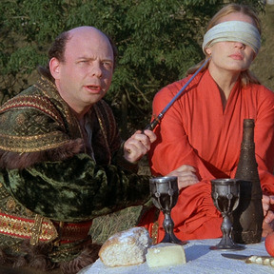
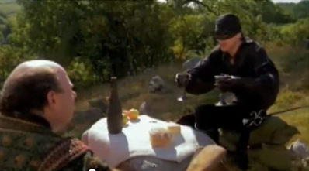
V- It's so simple. All I have to do is divine from what I know of you. Are you the sort of man who would put the poison into his own goblet or his enemy's? A clever man would put the poison into his own goblet because he would know that only a great fool would reach for what he was given. I am not a great fool, so I can clearly not choose the wine in front of you, but you must have known I was not a great fool! You would've counted on it so I can clearly not choose the wine in front of me. W- You have made your decision then? V- Not remotely, because iocane comes from Australia as everyone knows and Australia is entirely peopled with criminals and criminals are used to having people not trust them, as you are not trusted by me. So I can clearly not choose the wine in front of you. W- Truly you have a dizzying intellect. V- Wait till I get going. Where was I? W- Australia. V- Yes, Australia. You must have suspected I would have known the powder's origin so I can clearly not choose the wine in front of me. W- You're just stalling now. V- You'd like to think that wouldn't you? You've beaten my giant which means you're exceptionally strong so you could have put the poison in your own goblet trusting on your strength to save you, so I can clearly not choose the wine in front of you. But you've also bested my Spaniard which means you must have studied and in studying, you must have learned that man is mortal so you would have put the poison as far from yourself as possible, so I can clearly not choose the wine in front of me. W- You're trying to trick me into giving away something. It won't work. V- It has worked. You've given everything away. I know where the poison is. W- Then make your choice. V- I will, and I choose--- What in the world could that be? W- What? Where? [Vizzini changes cups!] I don't see anything. V- I could've sworn I saw something. No matter. [Vizzini laughs.] W- What's so funny? V- I'll tell you in a minute. First, let's drink, me from my glass and you from yours. [They drink.] W- You guessed wrong. V- You only think I guessed wrong. That's what's so funny. I switched glasses when your back was turned. You fool! You fell victim to one of the classic blunders. The most famous is "Never get involved in a land war with Asia." But only slightly less well known is this---"Never go in against a Sicilian when death is on the line."

Slide 39
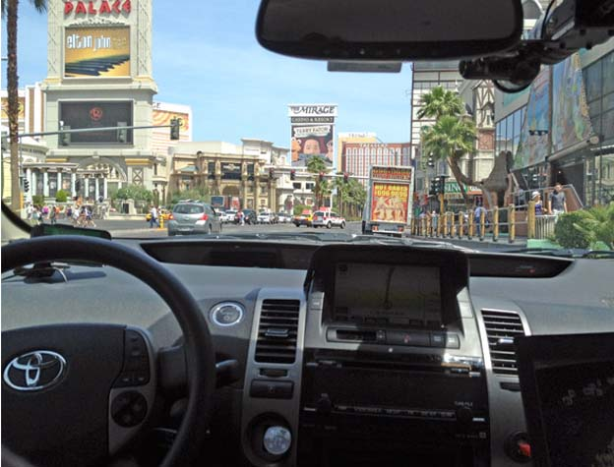
Big Open Questions: Performance Evaluation
In sufficiently complex environments, how can we meaningfully evaluate the performance of an intelligent system?

Slide 40
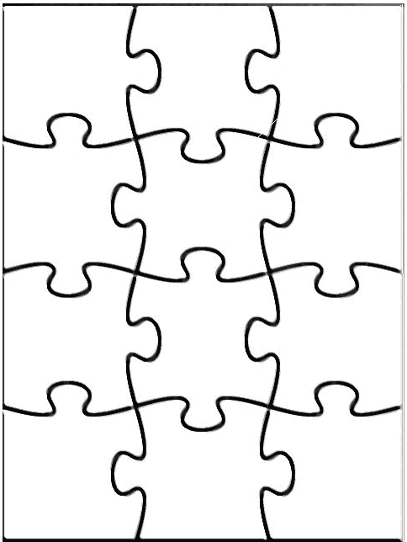
Agents in the bigger picture
Binds disparate fields (Econ, Cog Sci, OR, Control theory)
Framework for technical components of AI
Decision making with search
Machine learning
Casting problems in the framework sometimes brings insights
Agent
Perception
Robotics
Reasoning
Search
Learning
Knowledge rep.
Constraint satisfaction
Planning
Natural language
...
Expert
Systems

Slide 41
Upcoming Topics
Utility and decision theory (R&N 17.1-4)
Reinforcement learning
Decisions in partially-observable environments
Applications

Slide 42
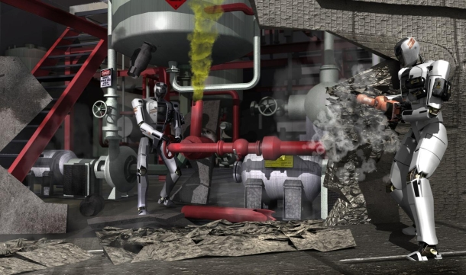
Plug: Intelligent Systems Seminar
Tomorrow at 3-4pm, Info E 150

